Slide 1
Image Enhancement
Shyna A
CSE DEPT., TKMCE

Slide 2
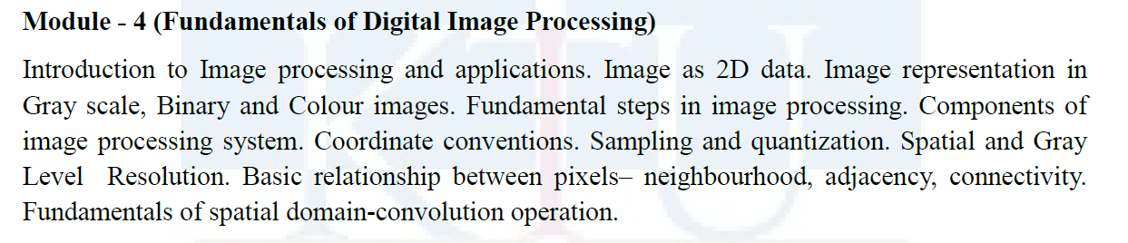
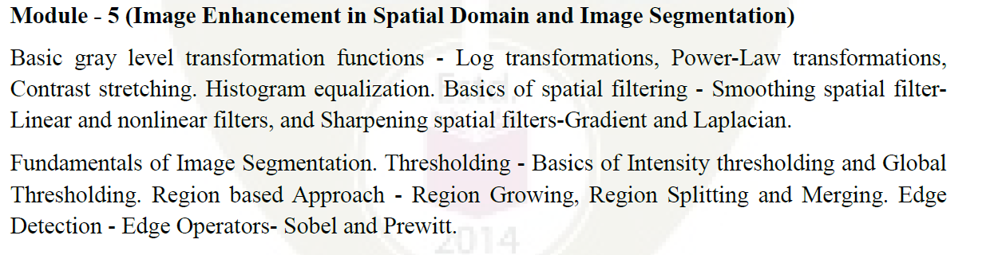

Slide 3
Image Enhancement
Necessity of Image Enhancement
Spatial Domain Approach
Frequency Domain Approach

Slide 4
Image Enhancement
Objective: Processing an image to enhance certain features of the image
Result is more suitable than original image
Processing techniques is application oriented

Slide 5
Two Approaches
Spatial domain
Direct manipulation of pixels
Point processing
Neighborhood processing(Mask Processing)
Frequency domain
Modify the Fourier transform of an image

Slide 6
Spatial domain -Background
Spatial domain processing
g(x,y)=T[ f(x,y) ]
f(x,y): input image
g(x,y): output image
T: operator
Defined over some neighborhood of (x,y)
f(x,y)
g(x,y)
T

Slide 7
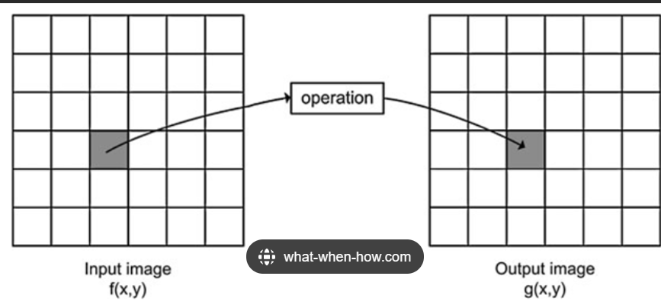
Point processing(Gray level transformation)
T applies to each pixel in the input image
1 X 1 Neighborhoods
Transformations maps pixel values r to s
s = T(r)

Slide 8
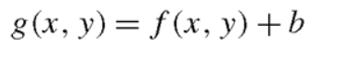
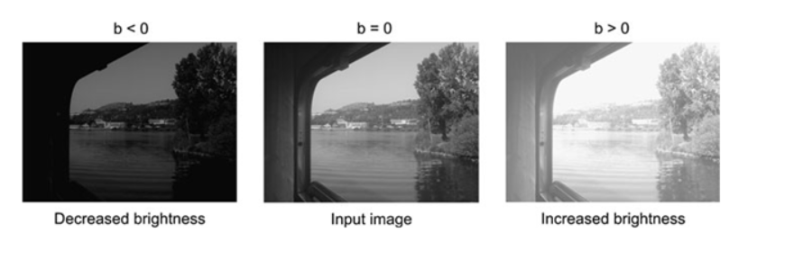

Slide 9
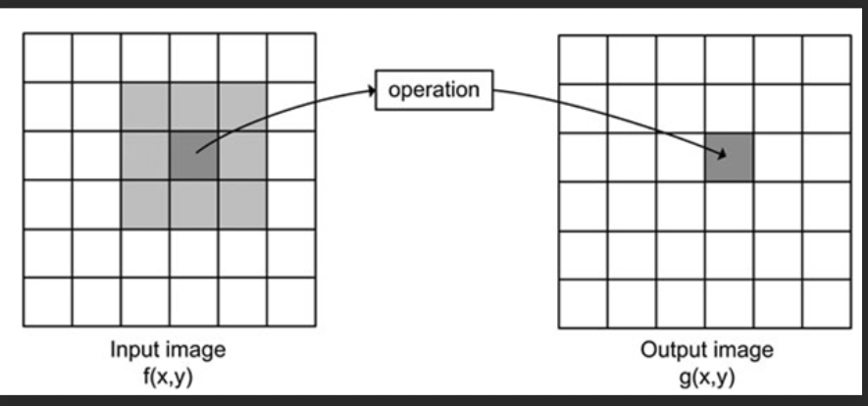
Neighborhood Processing (Mask processing or filtering)
* T operates over neighborhood of (x,y)

Slide 10
Neighborhood processing
A larger predefined neighborhood
Ex. 3x3 neighborhood
mask, filters, kernels, templates, windows

Slide 11
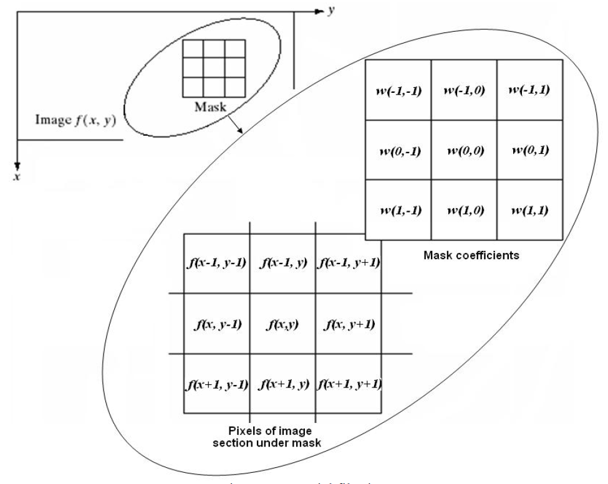
The mechanism of linear spatial filtering

Slide 12
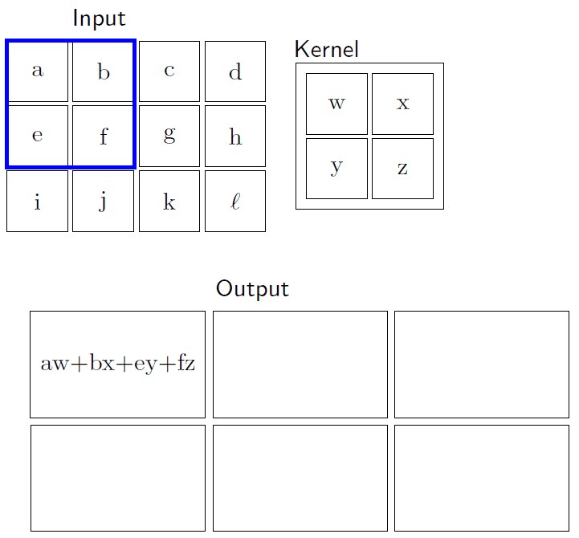

Slide 13
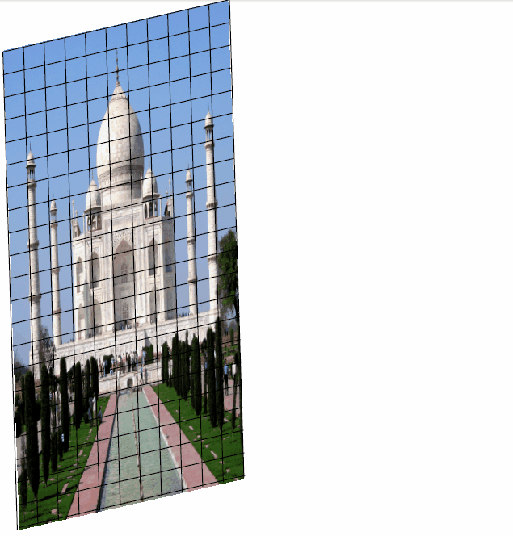
2D Convolution

Slide 14
Some Basic Gray Level Transformations
Or Point Processing Techniques
Image negatives (complement)
Log transformation
Power-law transform
Piece-wise linear transform
(a) Contrast Streching
(b) Gray level slicing
(c )Bit plane slicing

Slide 15
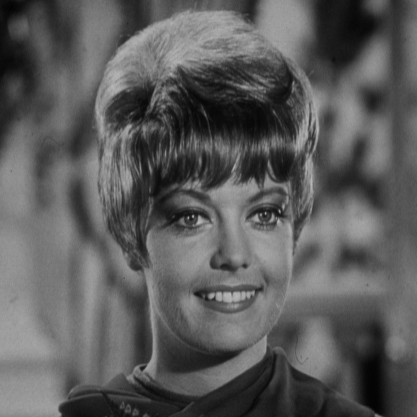
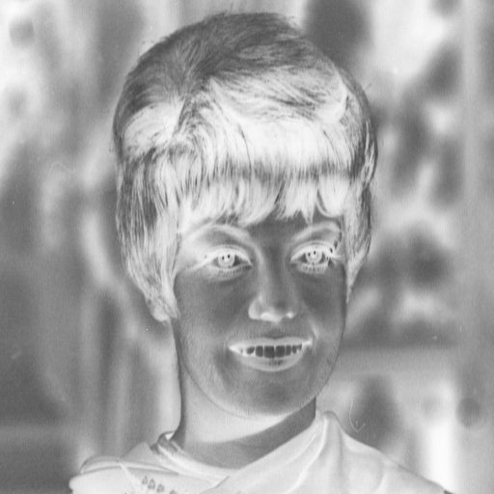
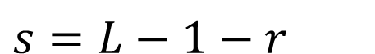
Digital Negative
s
L-1
$$s=L−1−r$$
r
0
L-1
Photographic negative
Suitable for images with dominant black areas

Slide 16
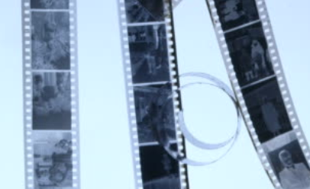

Slide 17
Digital negatives
Used for producing image equivalent to photographic negatives
Particularly suited for enhancing white or Gray details embedded in dark regions of an image ,especially when black regions are dominant in size.

Slide 18
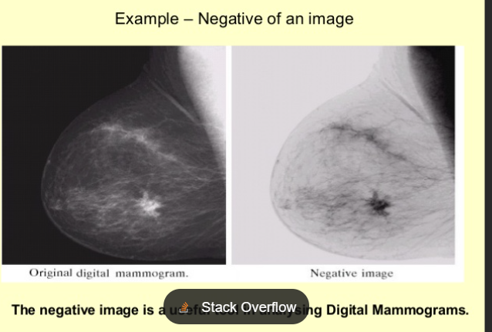

Slide 19
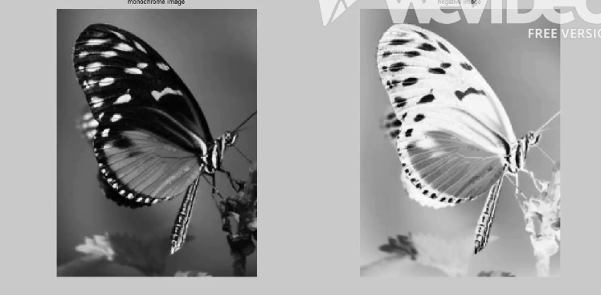

Slide 20
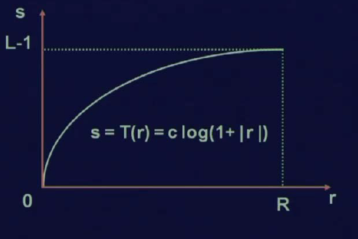
Log transformations
s = c log(1+r)
c is a constant
r>=1
Compress the dynamic range of images with large variation in pixel values

Slide 21
Maps narrow range of low gray level values in the input image to wider range of output values.
Opposite is true for the higher values of the input levels.
Reverse is the inverse log functions

Slide 22
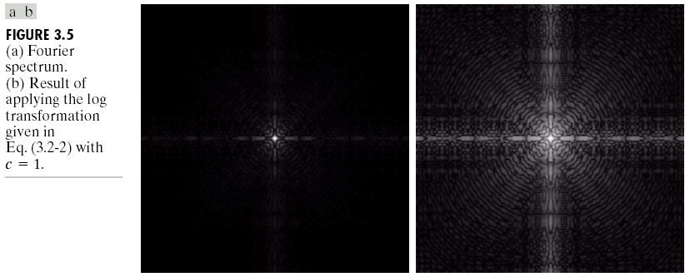
Example: Log transformations
log(fft2(I)) : log of Fourier transform:maps a narrow range of low gray level values in the input image into wider range of output levels
log

Slide 23
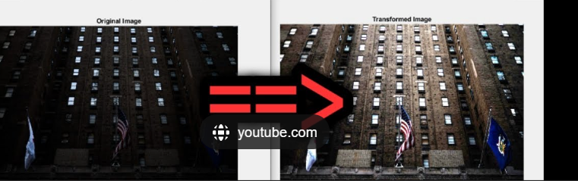

Slide 24
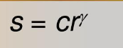
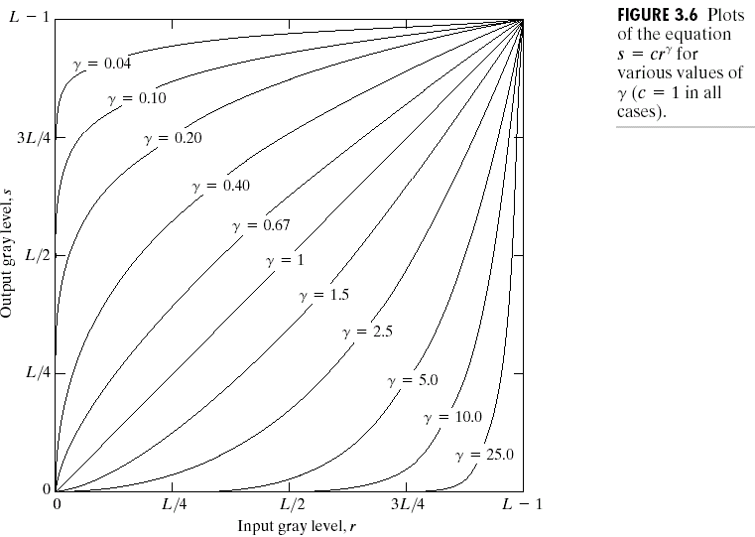
Power-law transformations

Slide 25
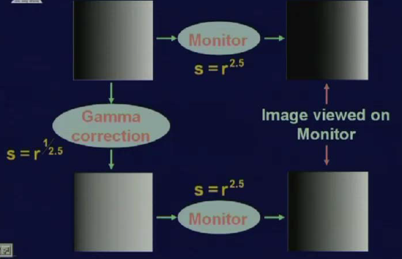

Slide 26
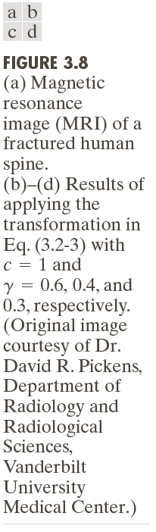
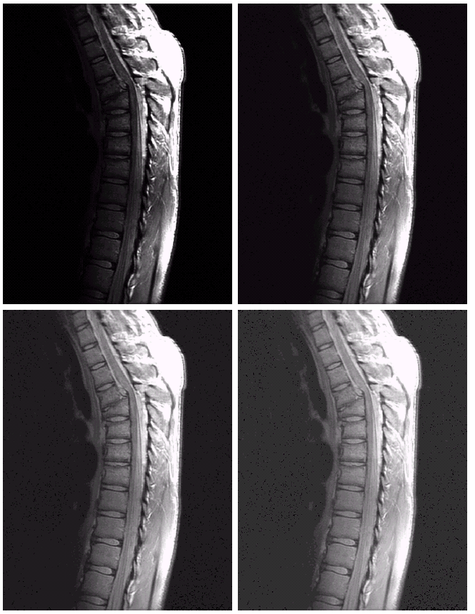
Power-law:
Darker image so
Expansion of gray level ids desirable
γ<1
γ=0.6
γ=0.4
γ=0.3

Slide 27
γ=0.6
γ=0.3
γ=0.4

Slide 28
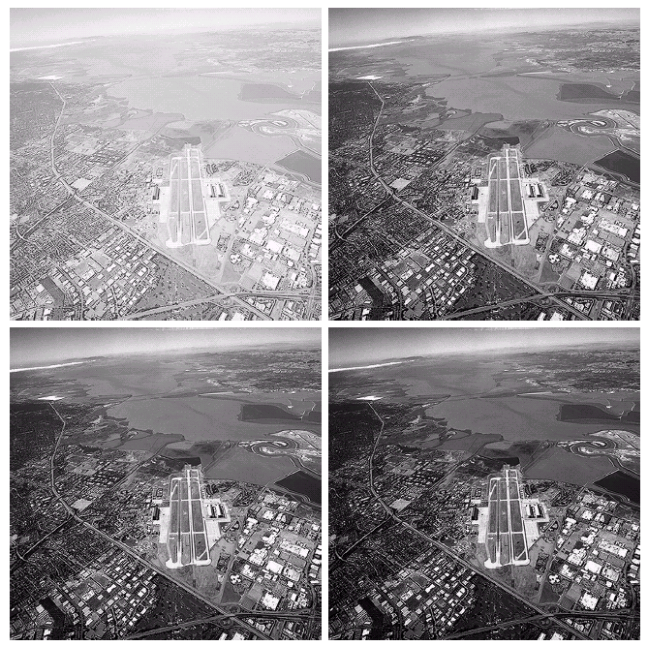
Power-law: γ>1
Washed out appearance
So compression of gray level is desirable
γ=3
γ=4
γ=5

Slide 29
Piece-wise linear transformation
(a) Contrast Streching
(b) Gray level slicing
(c )Bit plane slicing

Slide 30
Contrast Streching
Low contrast images can result from
Poor illumination
lack of dynamic range of the sensor
wrong setting of the lense

Slide 31
Contrast stretching
Is a process that expands the range of intensity levels in an image so that it spans the full intensity range of the recording medium or display devices.

Slide 32
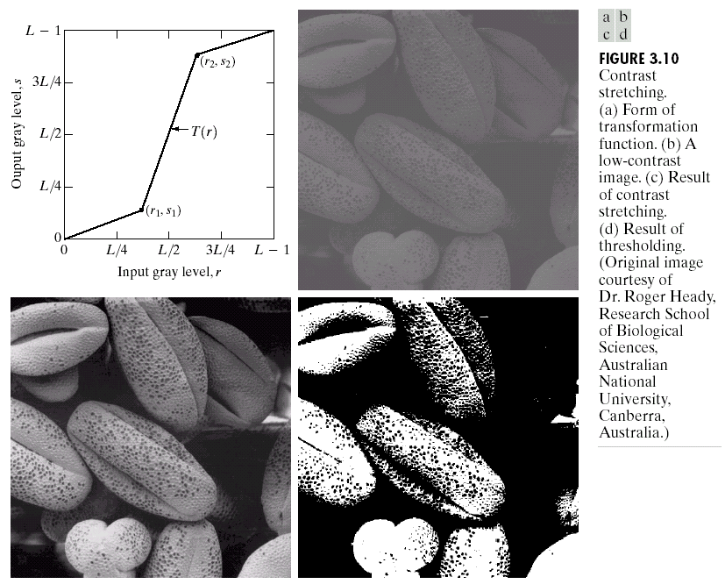
Contrast
stretching

Slide 33
r1=s1, r2=s2
r1=r2, s1=0, s2=L-1

Slide 34
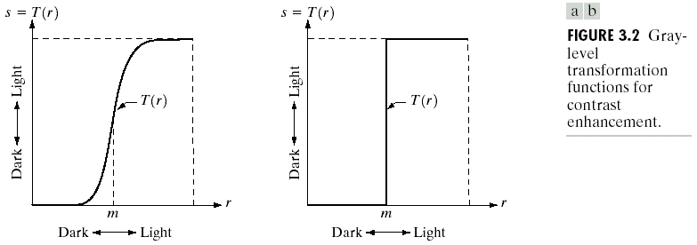

Slide 35
Contrast Stretching
thresholding

Slide 36
Gray Level Slicing
Highlighting a specific range of gray level
Similar to thresholding.
Other levels can be suppressed or maintained
Useful for highlighting features in an image

Slide 37
Gray-level slicing

Slide 38
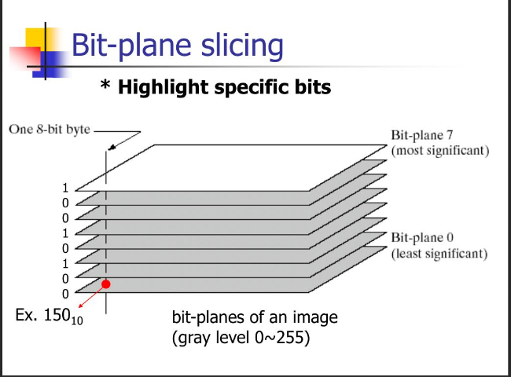

Slide 39
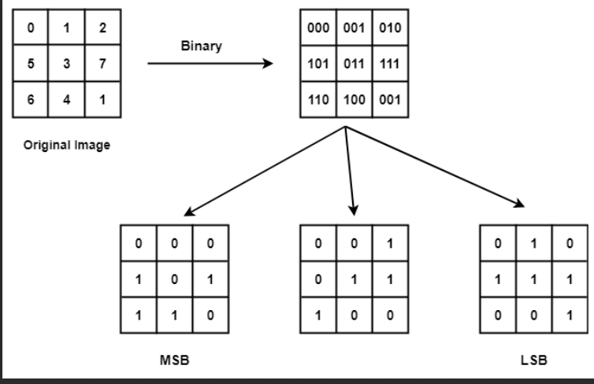
Bitplane slicing

Slide 40
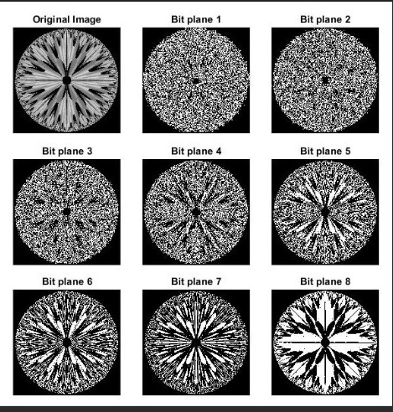

Slide 41
Histogram Processing & Mask Processing

Slide 42
Gray level histogram
An Image Histogram is a type of histogram that acts as a graphical representation of the lightness/color distribution in a digital image.
It plots the number of pixels for each intensity value.
Histogram of images provide a global description of their appearance.

Slide 43
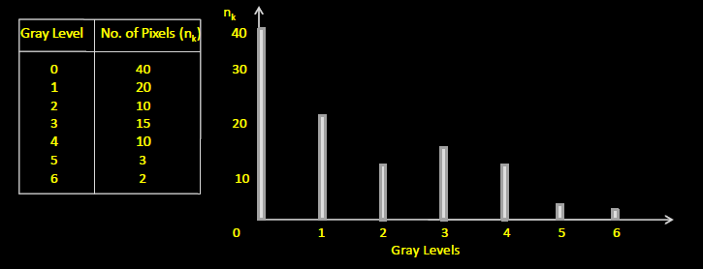

Slide 44


Slide 45
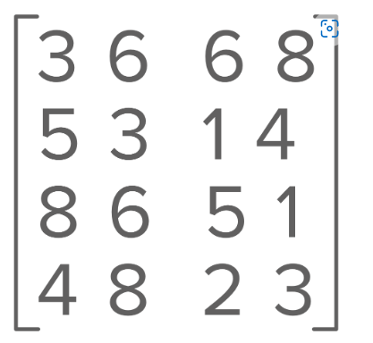

Slide 46
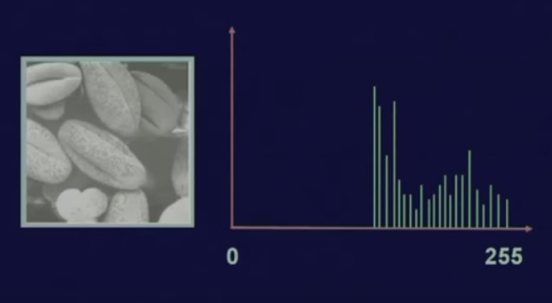
Bright Image

Slide 47
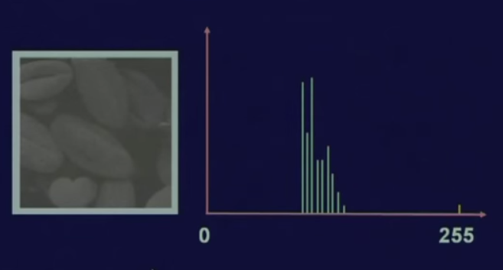
Low Contrast Image

Slide 48
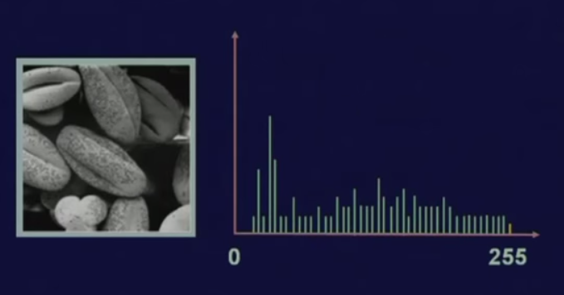
High Contrast Image

Slide 49
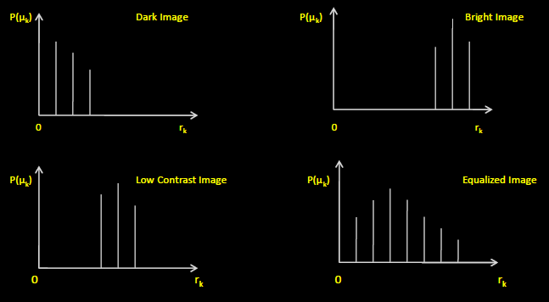

Slide 50
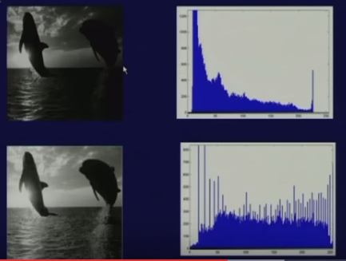
Histogram Equalisation

Slide 51
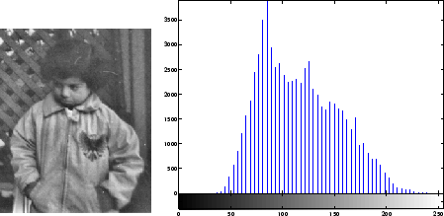
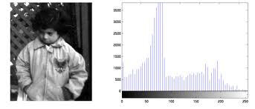

Slide 52
Can two different images can have same histogram ?????

Slide 53
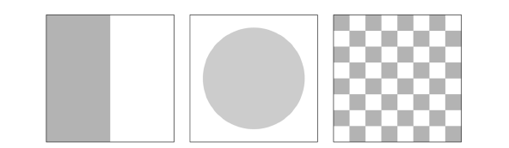

Slide 54
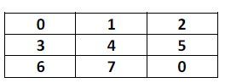
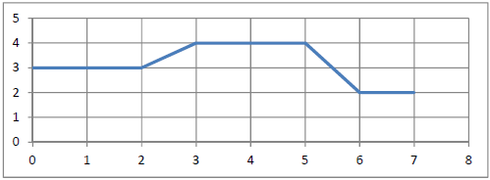
Tutorials
Show the output image if the following transformation is applied to the image. Show the histogram of
the new image.

Slide 55
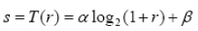
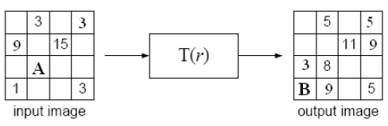
2. Given an image of size 4x4, 4- bits passes through an intensity transformation function given by:
Where α and β are constants, few pixels are available in the input and output
images, as shown below. Find the value of A and B

Slide 56
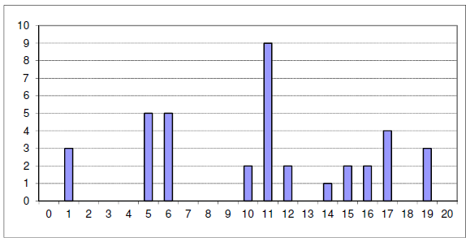
Consider an 8-bit image having the following histogram:
Assume that the least significant bit for each pixel in the image is set to 0. Show the histogram of this new image. Justify your answer.

Slide 57
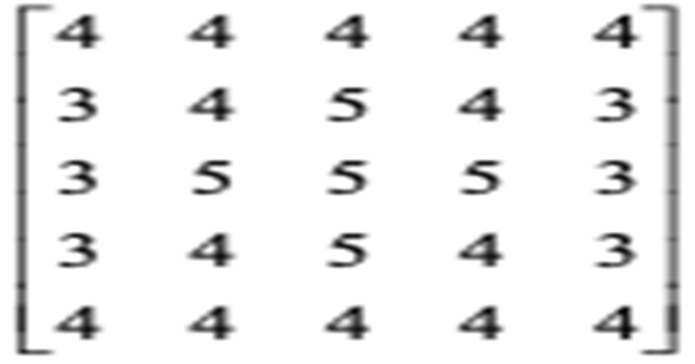
Histogram Equalization

Slide 58
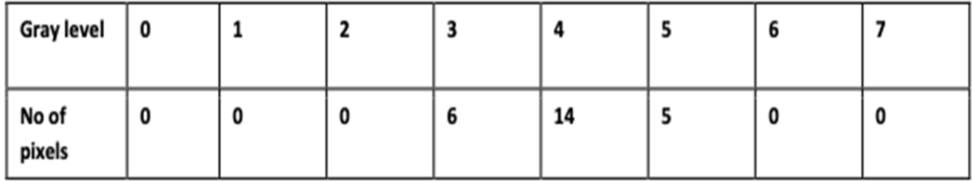
Maximum value is found to be 5. We need a minimum of 3 bits to represent the number.
There are 8 possible gray levels from 0 to 7
Histogram of input image:-

Slide 59
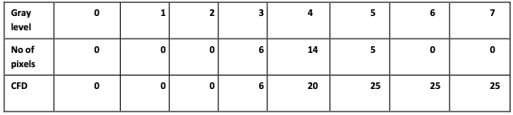
Step1: Compute the running sum of histogram values.
Running sum is otherwise known as Cumulative Frequency Distribution(CFD).

Slide 60
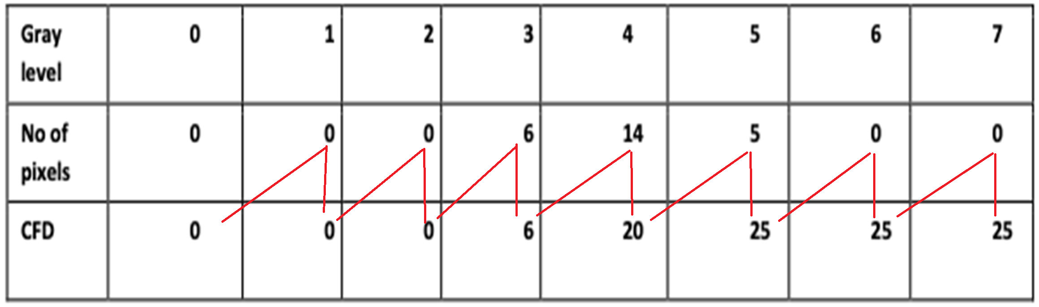

Slide 61
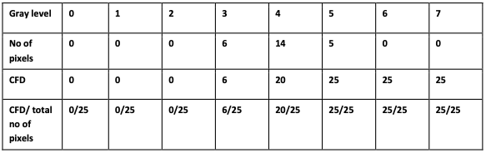
Step 2 : Divide the running sum obtained in step1 by the total number of pixels (which is 25 in this case).

Slide 62
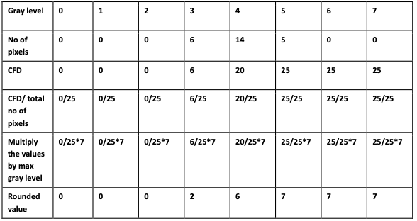
Step3: Multiply the values from step 2 by the maximum gray level value (which is 7 in this case). The result is then rounded to closest integer.

Slide 63


Histogram Processing - Histogram Equalization
Step 4: Map the gray level values to the results from step 3 using a one to one correspondence

Slide 64


Slide 65



Tutorial :- Histogram Equalization

Slide 66



Tutorial :- Histogram Equalization

Slide 67


Slide 68


Slide 69


Slide 70


Slide 71

modift
LSB-set to 0, What is the modified histogram?

Slide 72


Slide 73


